Slide 1
IN ASSOCIATION WITH
CELTIC FC
FOUNDATION
SUPPORTERS’
COMMITTEE

Slide 2
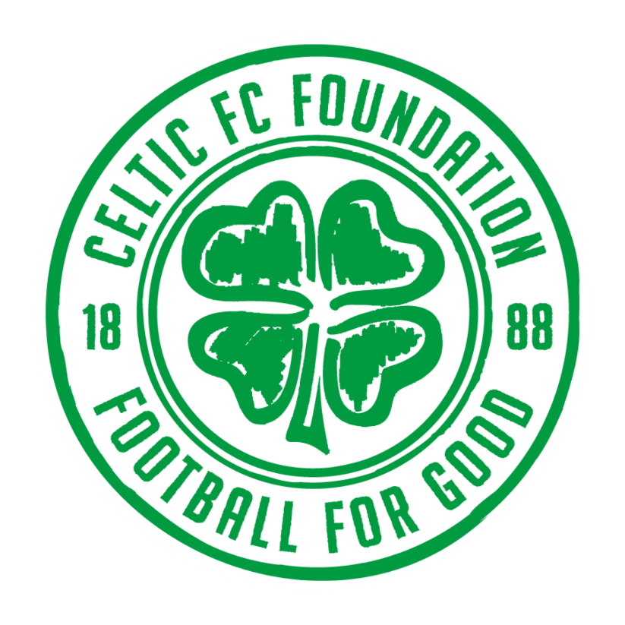
CELTIC FC FOUNDATION QUIZ : ROUND 1

Slide 3
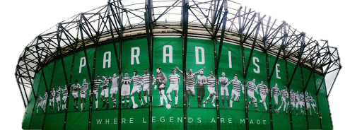
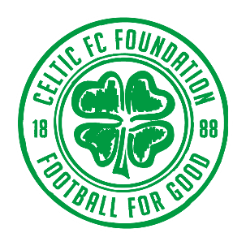
TAKE ME TO YOUR
I WANT TO SEE THE

Slide 4
NAME
ALL
EIGHT
CLUBS

Slide 5
ANSWERS
ROUND 1

Slide 6
2 points

Slide 7
2 points

Slide 8
2 points

Slide 9
2 points

Slide 10
2 points

Slide 11
2 points

Slide 12
VILLARREAL C.F.
2 points

Slide 13
2 points

Slide 14
BONUS 3 POINTS
WHICH TEAM IS THE
ODD ONE OUT
AND WHY?

Slide 15
BONUS 3 POINTS
ST. PAULI ARE THE ONLY CLUB WE HAVEN’T FACED IN EUROPE

Slide 16
Thanks to
Keith McGinty

Slide 17
CELTIC FC FOUNDATION QUIZ : ROUND 2

Slide 18
THE HISTORY 1
IF YOU KNOW

Slide 19
Celtic’s first ever match was a friendly held on May 28, 1888. The Hoops won 5-2 that afternoon, but who provided the opposition?

Slide 20
Celtic Football Club was formed with the objective of maintaining the dinner tables for the children of the East End.
In which church hall was the club founded?

Slide 21
James McGrory is officially ranked as the highest goal-scorer in British football history and is eighth worldwide.
How many goals did he score in his career?

Slide 22
How many times did Celtic clinch the league title at Celtic Park during our first nine-in-a-row run (1966-1974)?

Slide 23
After a 3-3 aggregate draw with Benfica in the 1970 European Cup, how did Celtic progress to the quarter-finals?

Slide 24
In the 1970 European Cup semi-final first leg at Elland Road, what was strange about the kit that Celtic wore that night?

Slide 25
Following the infamous bottle incident, where was the replayed second leg of the European Cup Winners’ Cup tie against Rapid Vienna held?

Slide 26
What was unusual about Celtic’s UEFA Cup clash with Sporting Lisbon at Celtic Park in 1993?

Slide 27
In the 2003/04 season, Martin O’Neill led Celtic to a record number of consecutive wins.
How many matches in a row did Celtic win?

Slide 28
Who scored the goal at Celtic Park in 1996, which provoked a roar so loud that it knocked Radio Five Live off air?

Slide 29
ANSWERS
ROUND 2

Slide 30
Celtic’s first ever match was a friendly held on May 28, 1888. The Hoops won 5-2 that afternoon, but who provided the opposition?
Rangers
2 points

Slide 31
Celtic Football Club was formed with the objective of maintaining the dinner tables for the children of the East End.
In which church hall was the club founded?
St. Mary’s (Calton)
2 points

Slide 32
James McGrory is officially ranked as the highest goal-scorer in British football history and is eighth worldwide.
How many goals did he score in his career?
550 goals in 547 games
Celtic career = 472 goals in 445 games
2 points

Slide 33
How many times did Celtic clinch the league title at Celtic Park during our first nine-in-a-row run (1966-1974)?
Zero – all nine titles were clinched away from home
2 points

Slide 34
After a 3-3 aggregate draw with Benfica in the 1970 European Cup, how did Celtic progress to the quarter-finals?
Toss of a coin
2 points

Slide 35
In the 1970 European Cup semi-final first leg at Elland Road, what was strange about the kit that Celtic wore that night?
We wore red socks.
2 points

Slide 36
Following the infamous bottle incident, where was the replayed second leg of the European Cup Winners’ Cup tie against Rapid Vienna held?
Old Trafford
2 points

Slide 37
What was unusual about Celtic’s UEFA Cup clash with Sporting Lisbon at Celtic Park in 1993?
Celtic wore their black
away top with white shorts
2 points

Slide 38
In the 2003/04 season, Martin O’Neill led Celtic to a record number of consecutive wins.
How many matches in a row did Celtic win?
25
2 points

Slide 39
Who scored the goal at Celtic Park in 1996, which provoked a roar so loud that it knocked Radio Five Live off air?
Jorge Cadete
2 points

Slide 40
Thanks to
Liam Kelly

Slide 41
CELTIC FC FOUNDATION QUIZ : ROUND 3

Slide 42
FOREHEADS
A GRAND
OLD TEAM
Name these Celts from their close-ups

Slide 43
1.

Slide 44
2.

Slide 45
3.

Slide 46
4.

Slide 47
5.

Slide 48
6.

Slide 49
7.

Slide 50
8.

Slide 51
9.

Slide 52
10.

Slide 53
ANSWERS
ROUND 3

Slide 54
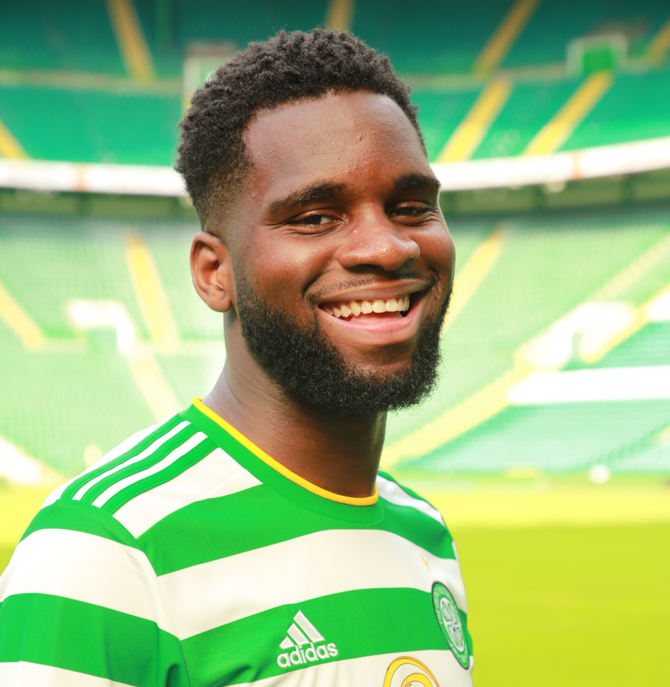
1. Odsonne Edouard
2 points

Slide 55
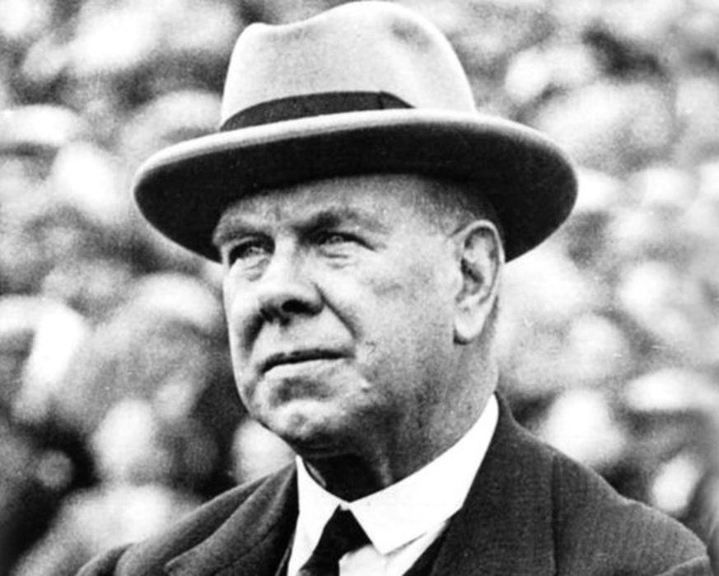
2. Willie Maley
2 points

Slide 56
3. Paddy McCourt
2 points

Slide 57
4. Danny McGrain
2 points

Slide 58
5. Callum McGregor
2 points

Slide 59
6. Davie Hay
2 points

Slide 60
7. Kelly Clark
2 points

Slide 61
8. Roy Aitken
2 points

Slide 62
9. Virgil van Dijk
2 points

Slide 63
10. Bertie Auld
2 points

Slide 64
Thanks to
Martin Friel

Slide 65
CELTIC FC FOUNDATION QUIZ : ROUND 4

Slide 66
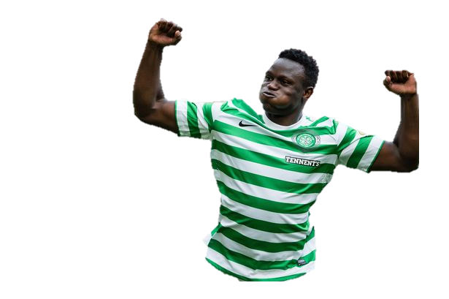
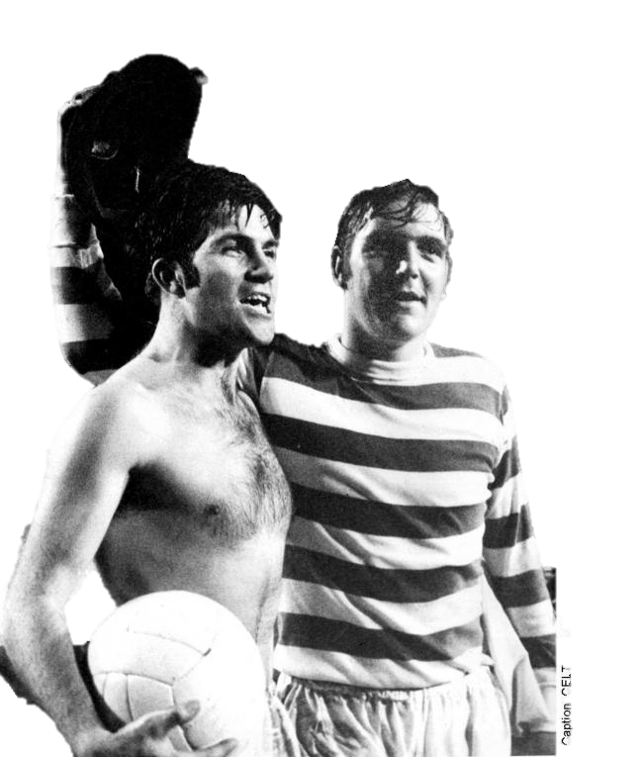
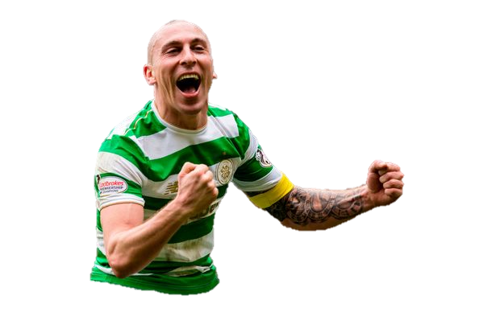
KNOWLEDGE
MIDFIELD
GENERAL

Slide 67
Celtic played in 14 consecutive League Cup finals between 1965-1978, how many did they win?

Slide 68
Which two players have played both for and against Celtic in the Champions League proper?

Slide 69
Who holds the record for scoring the most goals for Celtic in a single European match?

Slide 70
Which player, at the age of 36, is Celtic’s oldest debutant?
Hint: He debuted against Rangers, at Ibrox as a sub

Slide 71
On September 3, 1966, Willie O’Neill became the first player to do what for Celtic?
(in a League Cup tie against St. Mirren)

Slide 72
Who were the three non-Scottish players to start for Celtic in the 1995 Scottish Cup final?

Slide 73
Celtic only lost two games in the 1966/67 league campaign, both against the same side, who was it?

Slide 74
Which Celt is third top goal-scorer in SPL history? (1998-2013)

Slide 75
Who scored two goals against Partick Thistle at Firhill on his Celtic debut in September 1994?

Slide 76
Which eight Celtic players later went on to manage Hibs?

Slide 77
ANSWERS
ROUND 4

Slide 78
Celtic played in 14 consecutive League Cup finals between 1965-1978, how many did they win?
6
2 points

Slide 79
Which two players have played both for and against Celtic in the Champions League proper?
Henrik Larsson (Barcelona)
Aiden McGeady (Spartak Moscow)
2 points

Slide 80
Who holds the record for scoring the most goals for Celtic in a single European match?
Jacki Dziekanowski (4 goals)
2 points

Slide 81
Which player, at the age of 36, is Celtic’s oldest debutant?
Hint: He debuted against Rangers, at Ibrox as a sub
Dion Dublin
2 points

Slide 82
In September 3, 1966, Willie O’Neill became the first player to do what for Celtic?
(in a League Cup tie against St. Mirren)
He was Celtic’s first substitute
2 points

Slide 83
Who were the three non-Scottish players to start for Celtic in the 1995 Scottish Cup final?
Pierre Van Hooijdonk,
Pat Bonner and Rudi Vata
2 points

Slide 84
Celtic only lost two games in the 1966/67 league campaign, both against the same side, who was it?
Dundee United
2 points

Slide 85
Which Celt is third top goal-scorer in SPL history? (1998-2013)
Derek Riordan
2 points

Slide 86
Who scored two goals against Partick Thistle at Firhill on his Celtic debut in September 1994?
Phil O’Donnell
2 points

Slide 87
Which eight Celtic players later went on to manage Hibs?
Neil Lennon, Alan Stubbs, John Hughes,
John Collins, Tony Mowbray, Pat Stanton,
Bertie Auld and Jock Stein
Not including Jim Duffy as he only played friendlies and Glasgow Cup for Celtic
4 points

Slide 88
Thanks to
Keith McGinty

Slide 89
CELTIC FC FOUNDATION QUIZ : ROUND 5

Slide 90
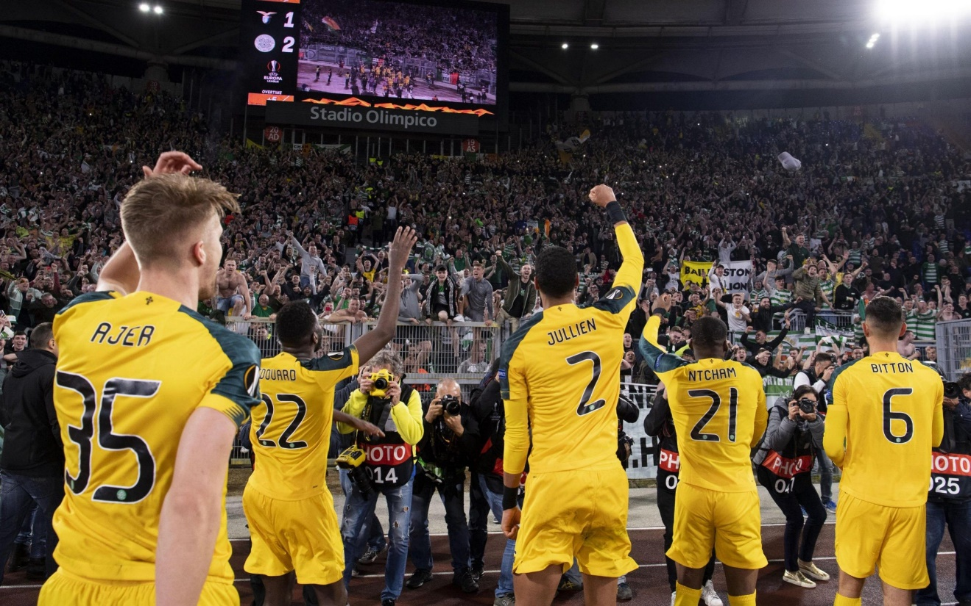
AWAY TO WATCH THE CELTIC
Name each of the grounds Celtic
have played at from their aerial view

Slide 91
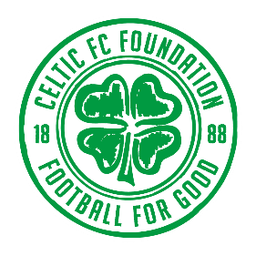
1.

Slide 92
2.

Slide 93
3.

Slide 94
4.

Slide 95
5.

Slide 96
6.

Slide 97
7.

Slide 98
8.

Slide 99
9.

Slide 100
10.

Slide 101
ANSWERS
ROUND 5

Slide 102
1. Estadio Nacional – Inter ‘67
2 points

Slide 103
2. Murrayfield – Reykjavik / Legia Warsaw / Hearts
2 points

Slide 104
3. Wembley – Spurs / Al Ahly
2 points

Slide 105
4. San Siro / Guiseppe Meazza – Inter/A.C. Milan
2 points

Slide 106
5. Lerkendal Stadion – Rosenborg
2 points

Slide 107
6. Estádio Municipal – Braga
2 points

Slide 108
7. Astana Arena – Shakhter Karagandy / Astana
2 points

Slide 109
8. Borussia-Park - BMG
2 points

Slide 110
9. Victoria Stadium – Lincoln Red Imps
2 points

Slide 111
10. Le Parc des Princes - PSG
2 points

Slide 112
Thanks to
Keith McGinty

Slide 113
CELTIC FC FOUNDATION QUIZ : ROUND 6

Slide 114
THE HISTORY 2
IF YOU KNOW

Slide 115
The Lisbon Lions were all said to have been born within how many miles of Celtic Park?

Slide 116
What was Martin O’Neill’s first competitive match in charge and what was the score?

Slide 117
By how many points did
‘The Invincibles’ win the league?

Slide 118
Moussa Dembele’s hat-trick against Rangers in the 5-1 victory was the first hat-trick in the fixture since the 1970s.
Who was the last Celtic player to achieve the same feat all those years before?

Slide 119
Who was Celtic’s first million pound player?

Slide 120
Who was the first Celtic player to say he had won the World Cup?

Slide 121
At the end of the 1959/60 season Celtic played several friendly matches. What fact was
particularly remarkable about the game against Sparta Rotterdam – other than the 5-1 victory that Celtic recorded?

Slide 122
After defeating St Johnstone to win the league on May 9, 1998, Celtic played in a match only four days later. Who were the opposition?

Slide 123
Bobby Petta left Celtic on loan during the 2003/04 season. To which English side did he move?

Slide 124
Neil Lennon scored two competitive goals away from Celtic Park, who did he score against?

Slide 125
ANSWERS
ROUND 6

Slide 126
The Lisbon Lions were all said to have been born within how many miles of Celtic Park?
30 miles
2 points

Slide 127
What was Martin O’Neill’s first competitive match in charge and what was the score?
Dundee United 1-2 Celtic
(Sutton, Larsson)
2 points

Slide 128
By how many points did ‘The Invincibles’ win the league?
30
2 points

Slide 129
Moussa Dembele’s hat-trick against Rangers in the 5-1 victory was the first hat-trick in the fixture since the 1970s.
Who was the last Celtic player to achieve the same feat all those years before?
Harry Hood
2 points

Slide 130
Who was Celtic’s first million pound player?
John Collins
(£1million from Hibs, July 1990)
2 points

Slide 131
Who was the first Celtic player to say he had won the World Cup?
Juninho
2 points

Slide 132
At the end of the 1959/60 season Celtic played several friendly matches. What fact was
particularly remarkable about the game against Sparta Rotterdam – other than the 5-1 victory that Celtic recorded?
Celtic wore numbers on their
shorts for the first time
2 points

Slide 133
After defeating St Johnstone to win the league on May 9, 1998, Celtic played in a match only four days later. Who were the opposition?
Sporting Lisbon in a friendly – poor crowd due to the ill feeling towards Cadete
2 points

Slide 134
Bobby Petta left Celtic on loan during the 2003/04 season. To which English side did he move?
Fulham
2 points

Slide 135
Neil Lennon scored two competitive goals away from Celtic Park, who did he score against?
Dunfermline at East End Park
2 points

Slide 136
Thanks to
Bryan McManus

Slide 137
CELTIC FC FOUNDATION QUIZ : ROUND 7

Slide 138
Name the Celts from the
clubs they have played for

Slide 139
?
Inverness Caledonian Thistle
Forfar Athletic
Dundee United
Celtic
Middlesbrough
Vancouver Whitecaps
Sheffield United
Aberdeen

Slide 140
?
Celtic
Norwich City
Reading
Bournemouth

Slide 141
?
Nitra
St. Etienne
Bastia
Duisburg
Celtic
JEF United

Slide 142
?
Crystal Palace
Arsenal
West Ham
Nottingham Forest
Celtic
Burnley

Slide 143
?
Aston Villa
Motherwell
Celtic
Man United
Motherwell

Slide 144
?
Tatran Presov
Slovan Bratislava
Sunderland
West Brom
Celtic
Sunderland
Burnley

Slide 145
?
Celtic
San Jose Earthquakes
Sheffield United
Dundee
Shelbourne
Elgin City

Slide 146
?
Dumbarton
Celtic
Borussia Dortmund
Hibs
Dumbarton
Partick Thistle

Slide 147
?
KTP
Sevilla
HJK Helsinki
Schalke
Celtic
Brondby
Norwich City

Slide 148
?
Celtic
Livingston
ADO Den Haag
Aberdeen
Colorado Rapids

Slide 149
ANSWERS
ROUND 7

Slide 150
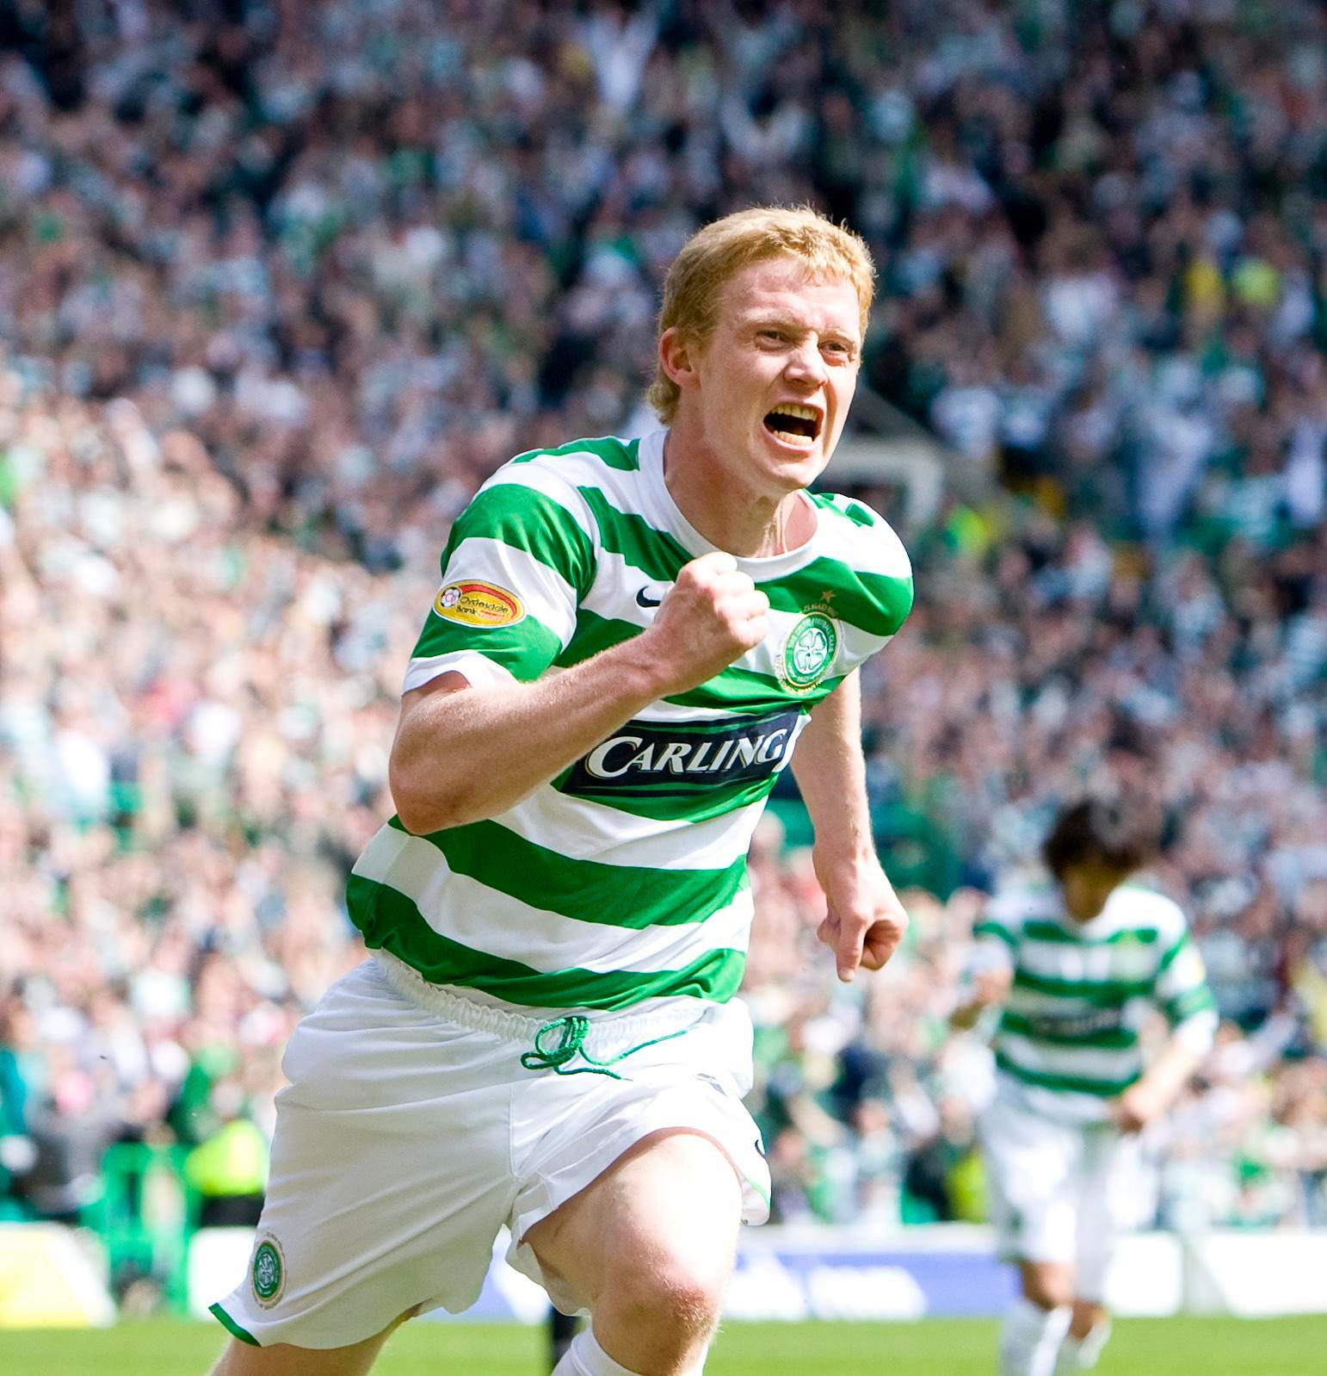
Inverness Caledonian Thistle
Forfar Atheltic
Dundee United
Celtic
Middlesbrough
Vancouver Whitecaps
Sheffield United
Aberdeen
Barry Robson
2 points

Slide 151
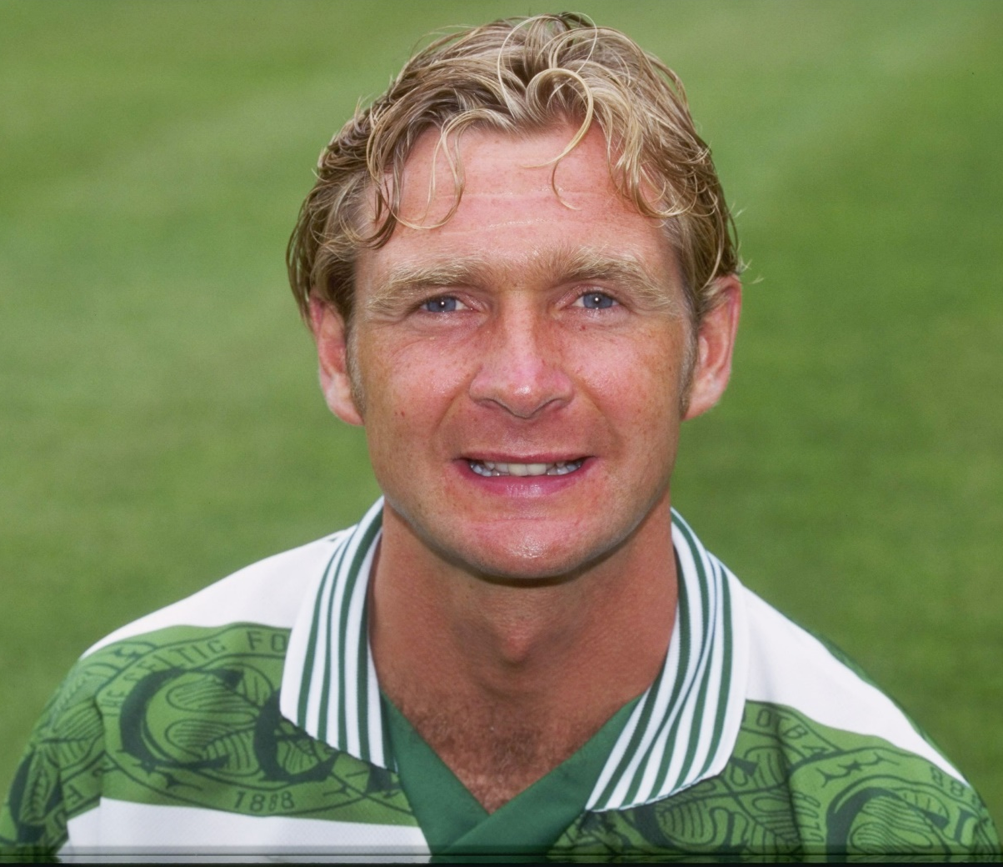
Celtic
Norwich City
Reading
Bournemouth
Peter Grant
2 points

Slide 152
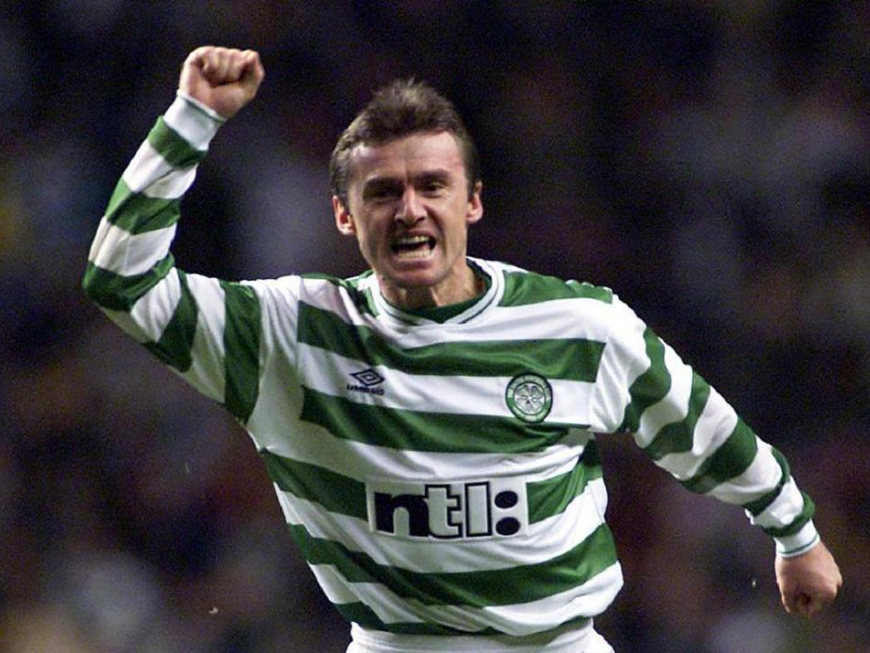
Nitra
St. Etienne
Bastia
Duisburg
Celtic
JEF United
Ľubomír Moravčík
2 points

Slide 153
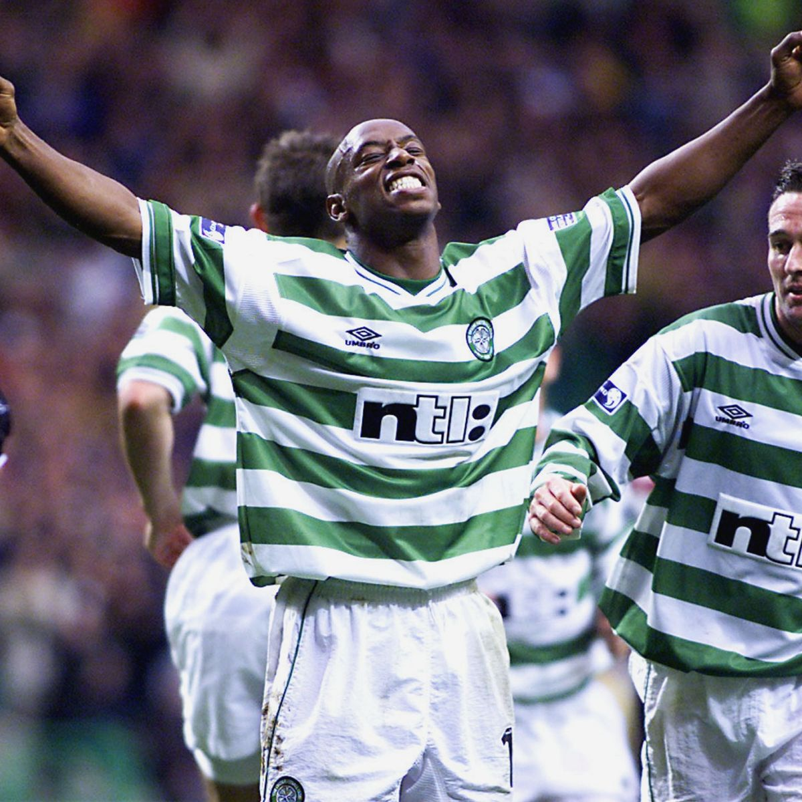
Crystal Palace
Arsenal
West Ham
Nottingham Forest
Celtic
Burnley
Ian Wright
2 points

Slide 154
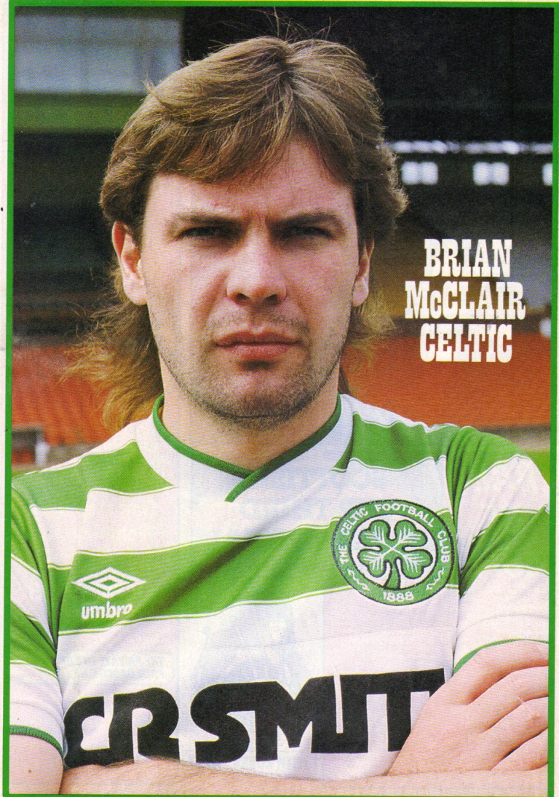
Aston Villa
Motherwell
Celtic
Man United
Motherwell
Brian McClair
2 points

Slide 155
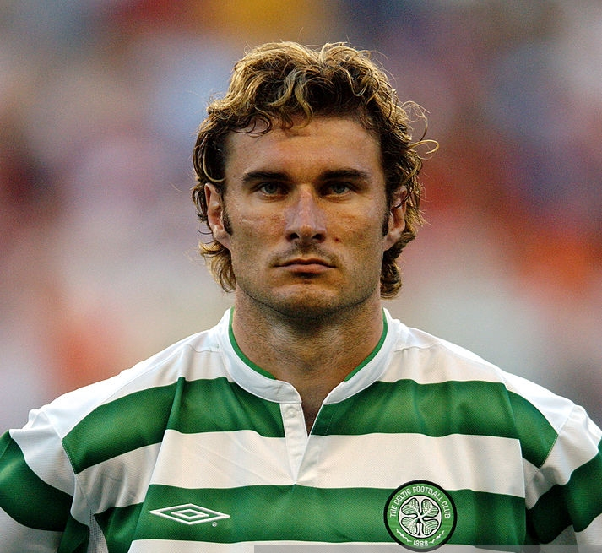
Tatran Presov
Slovan Bratislava
Sunderland
West Brom
Celtic
Sunderland
Burnley
Stanislav Varga
2 points

Slide 156
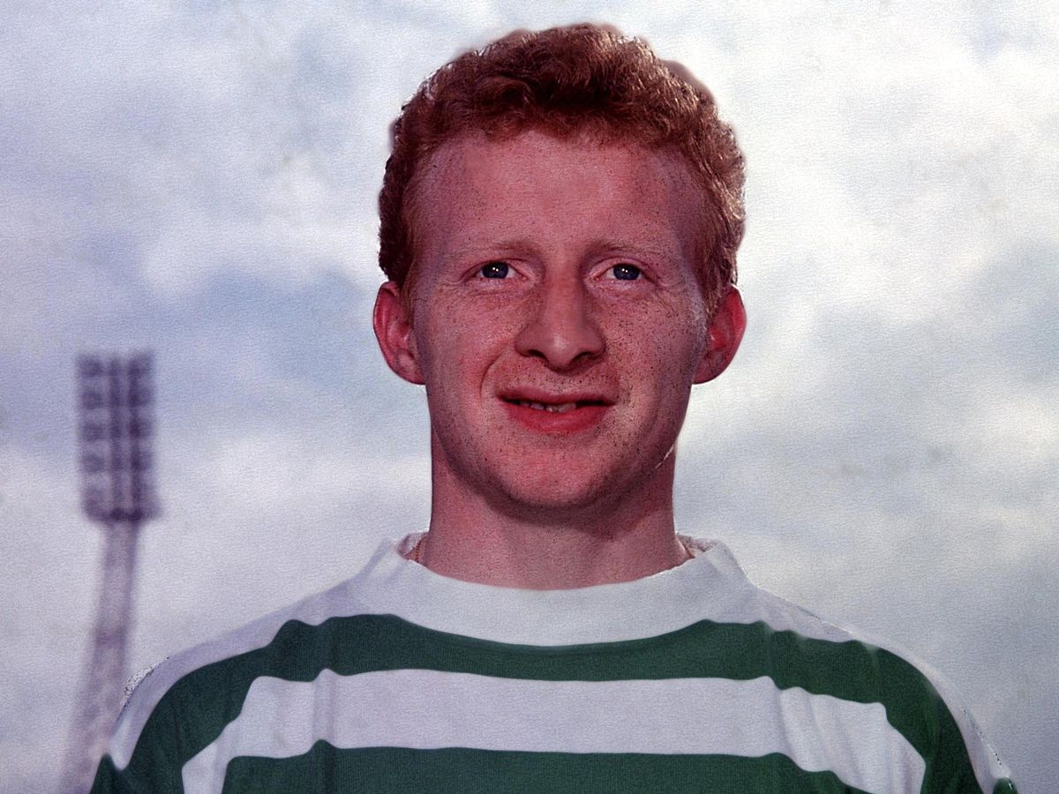
Celtic
San Jose Earthquakes
Sheffield United
Dundee
Shelbourne
Elgin City
Jimmy Johnstone
2 points

Slide 157
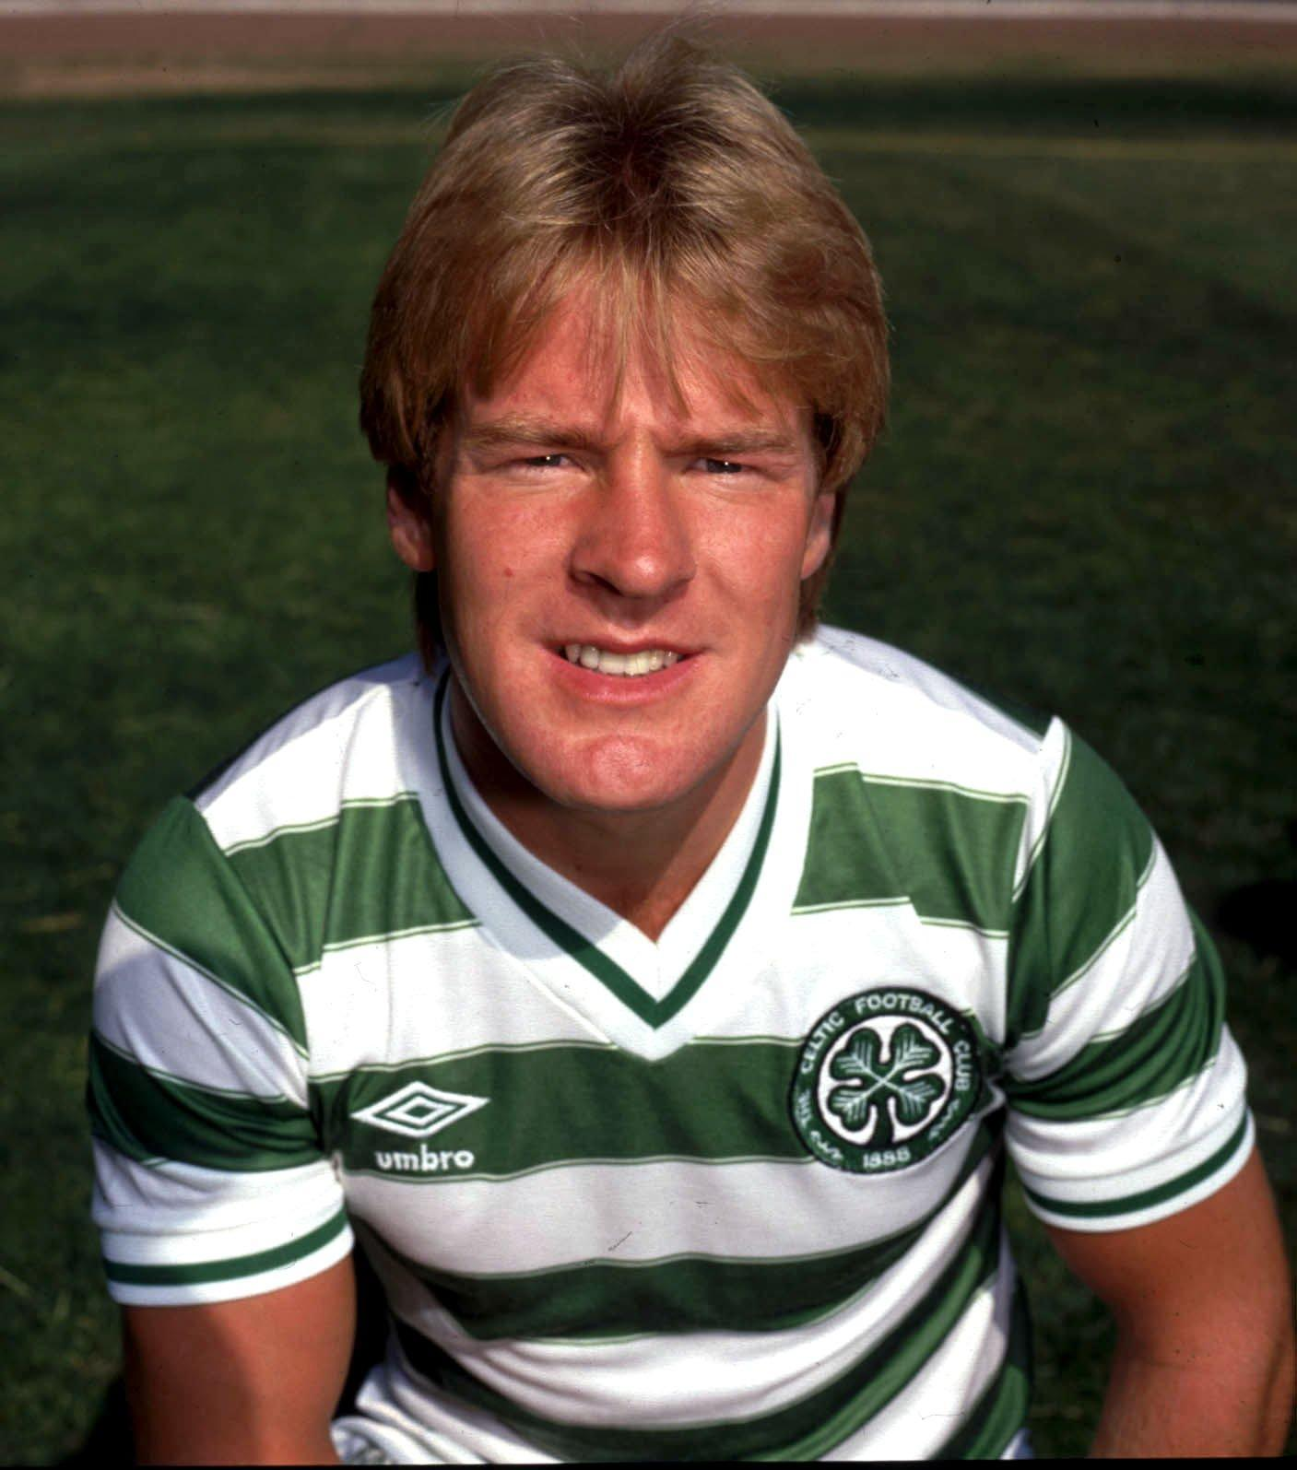
Dumbarton
Celtic
Borussia Dortmund
Hibs
Dumbarton
Partick Thistle
Murdo MacLeod
2 points

Slide 158
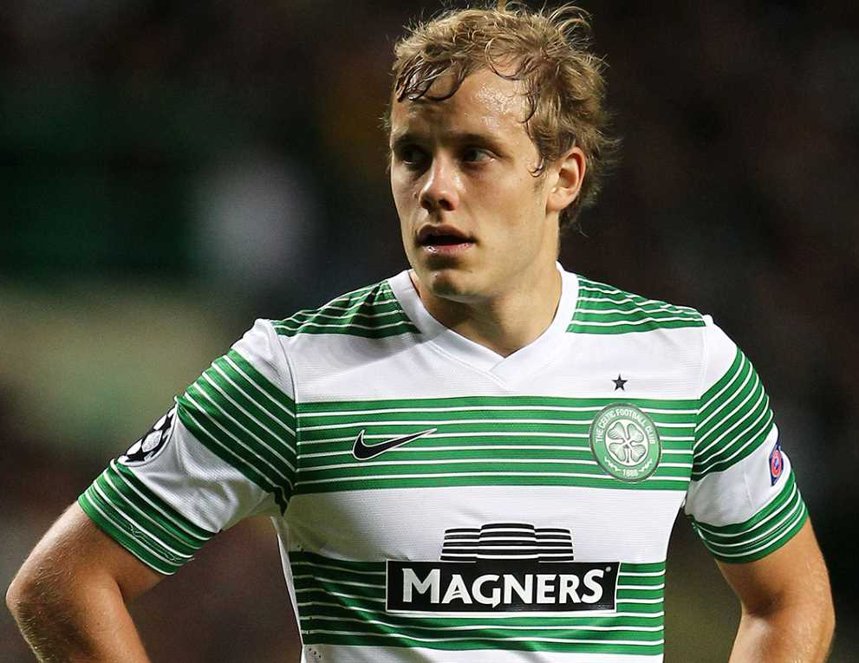
KTP
Sevilla
HJK Helsinki
Schalke
Celtic
Brondby
Norwich City
Teemu Pukki
2 points

Slide 159
Celtic
Livingston
ADO Den Haag
Aberdeen
Colorado Rapids
Jamie Smith
2 points

Slide 160
Thanks to
Keith McGinty

Slide 161
A tiebreaker question is available on the following slides, should it be required to determine a winner.
A huge thank you for taking part and for your wonderful support. We hope you enjoyed the quiz.

Slide 163
CELTIC FC FOUNDATION QUIZ : TIEBREAKER

Slide 164
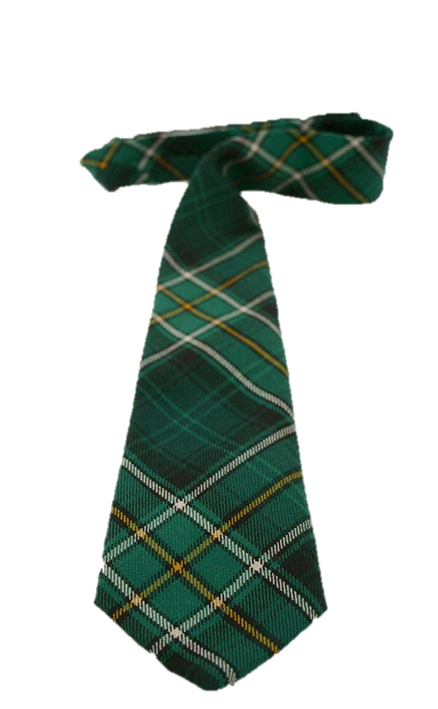
IEBREAKER
What was the official attendance of
the 6-2 game on August 27, 2000?

Slide 165
ANSWER
TIEBREAKER

Slide 166
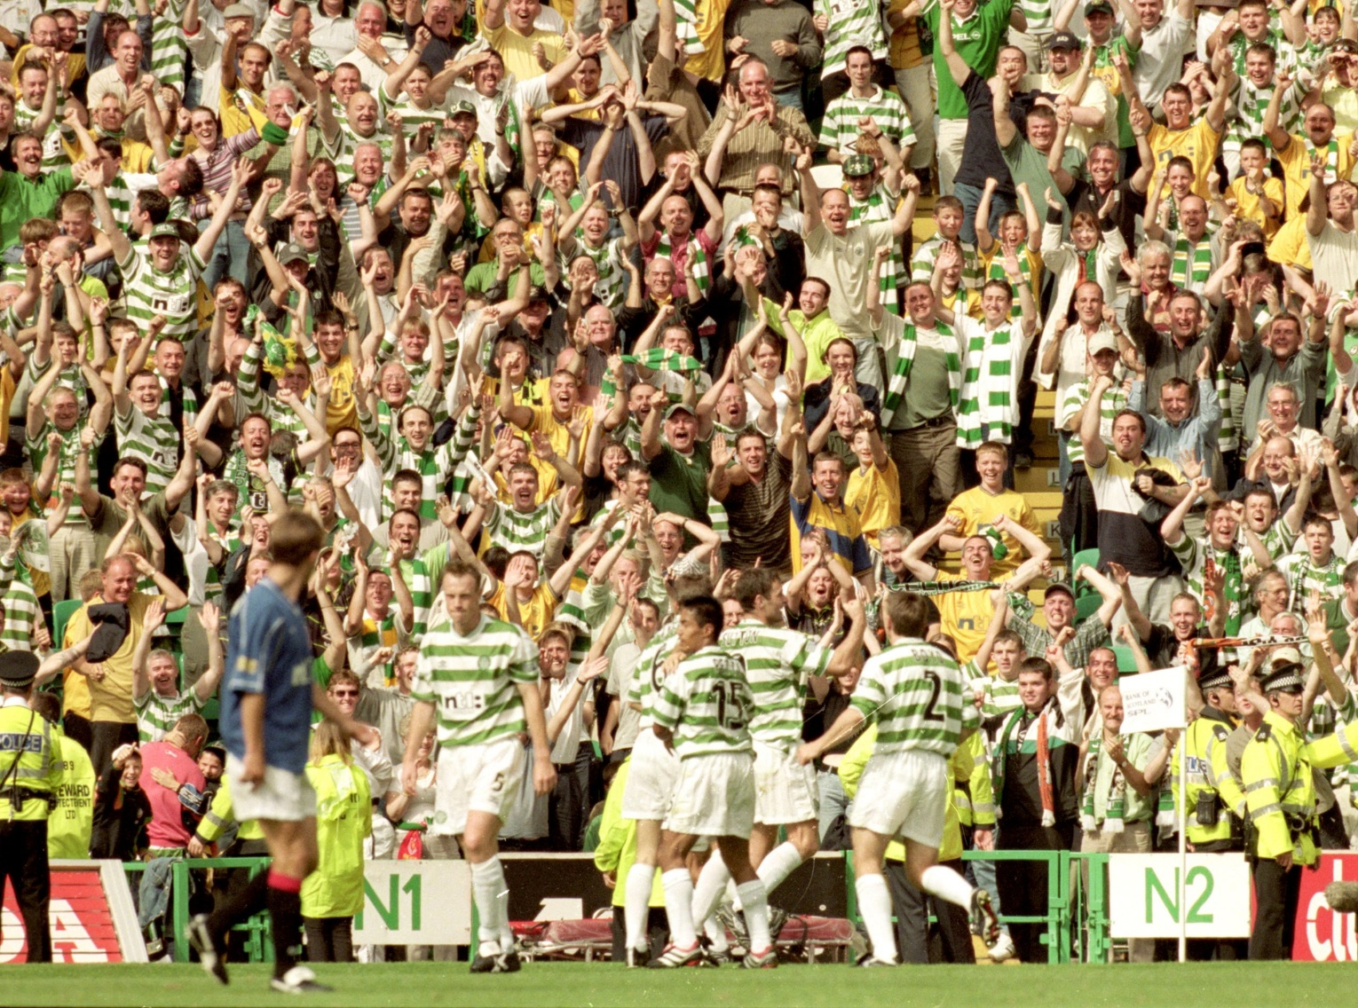
Official Attendance: 59,476

